Slide 1

Credit Risk
DA 6813
Brandi Rodriguez

Slide 2
Agenda
Background
Motivation
Data
Analysis
Findings
Conclusions and Recommendations

Slide 3
Background
Credit risk is the risk that promised cash flows from the loans and securities held by banks are not paid in full
Banks apply credit scoring models to determine if a customer is a good or bad credit risk
The most highly used credit scoring measure is probability of default
Defaulter is a borrower who is unlikely to repay the loan amount or has an overdue loan payment by 90+ days

Slide 4
Motivation
Limit credit risk exposure by issuing loans to most credible customers
Use classification predictive modeling to predict the status of whether a borrower will default on a loan
What are the most important predictors of default?
Which model is most accurate in predicting loan defaults?

Slide 5
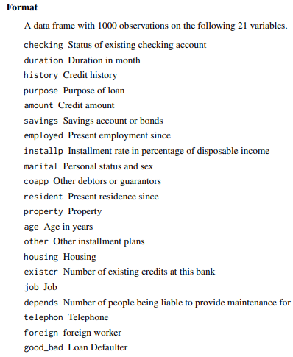
Data
German Bank Credit Dataset from the UCI Machine Learning Repository
https://archive.ics.uci.edu/ml/datasets/statlog+(german+credit+data)
Package ‘RSADBE’: data(GC)
https://cran.r-project.org/web/packages/RSADBE/RSADBE.pdf
Recoding labels:
http://www1.beuth-hochschule.de/FB_II/reports/Report-2019-004.pdf
1,000 observations
20 attributes
3 integer
17 categorical
Binary Response Variable = ‘response’
1 = Good
2 = Bad

Slide 6
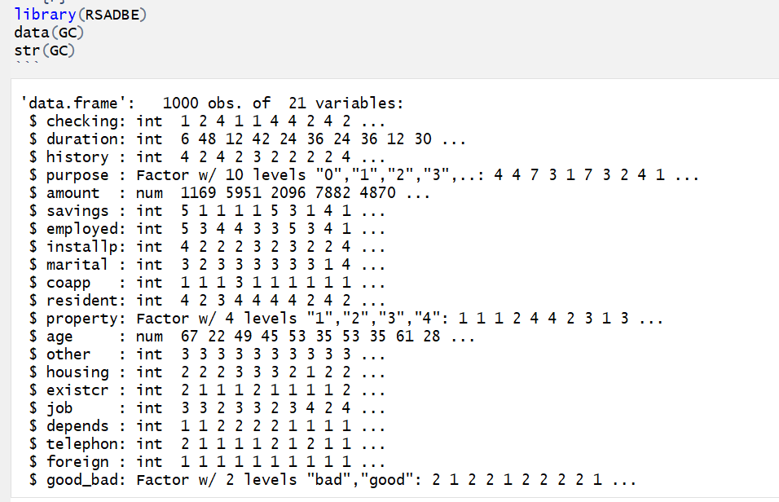

Slide 7
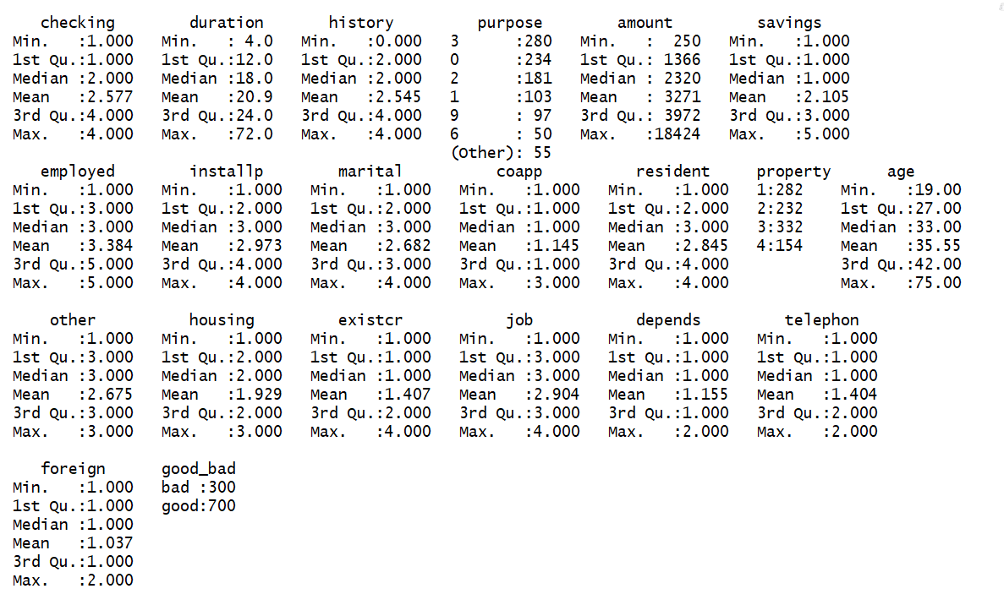

Slide 8
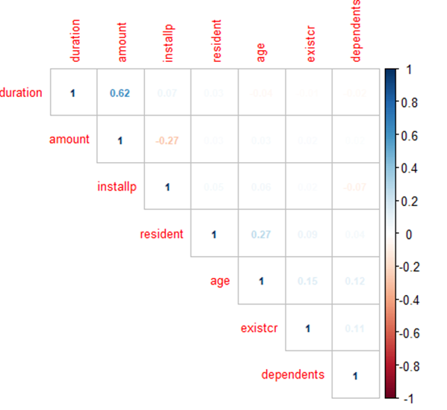
Data Preprocessing
Binning for some quantitative variables (i.e. amount in checking and savings)
Coerce numeric to factor variables
Original dataset imported with only 3 factor variables
Preprocessed data contains 14 factor variables
6 remaining numeric variables
Duration, Amount, Installp, Resident, Age, Exist, Dependents
No missing values
No highly correlated variables
Notes:
- Binning helps

Slide 9
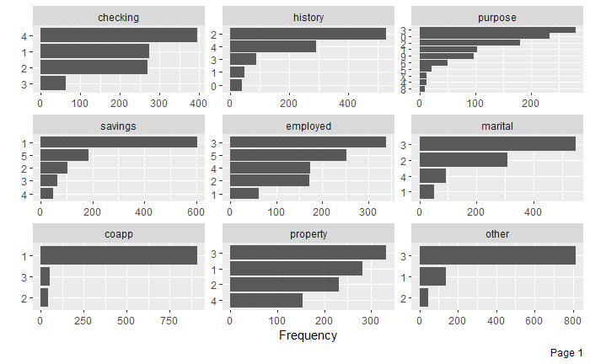
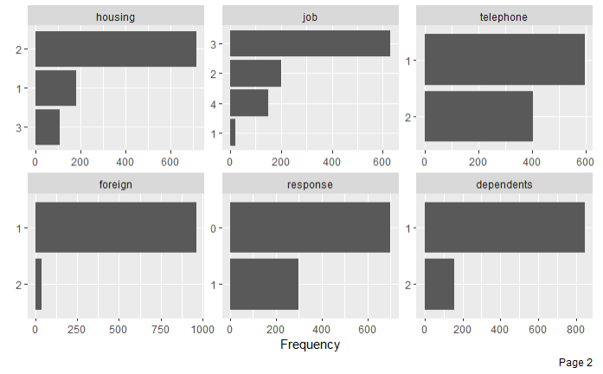
EDA using DataExplorer Package Categorical Variables
Notes:
DataExplorer sorts by majority class

Slide 10
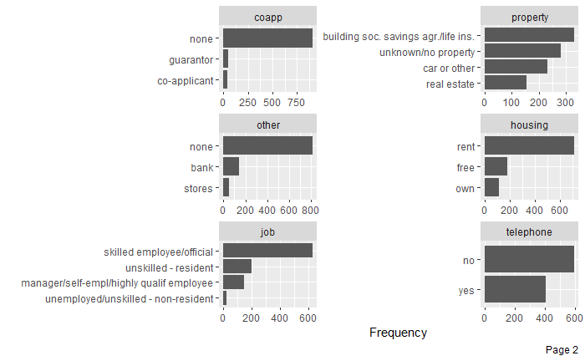
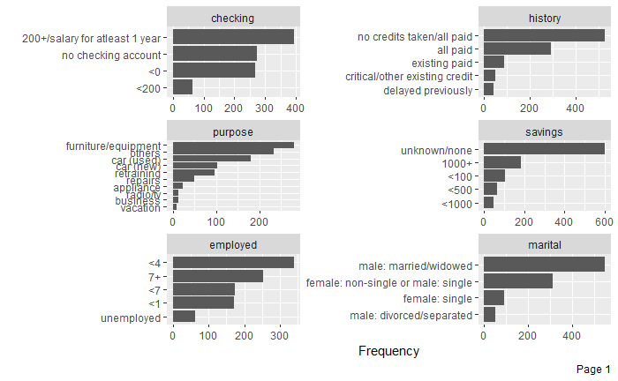
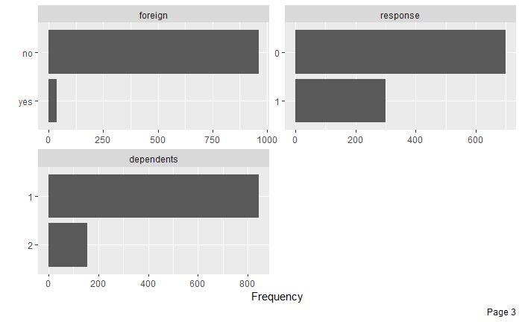
Categorical Variables (Factor Levels Renamed)

Slide 11
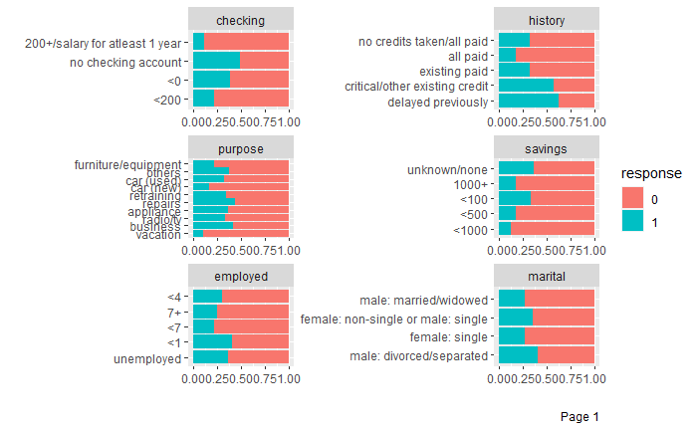
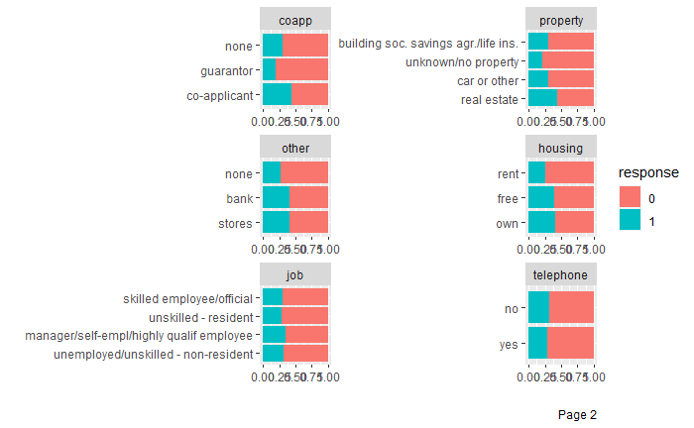
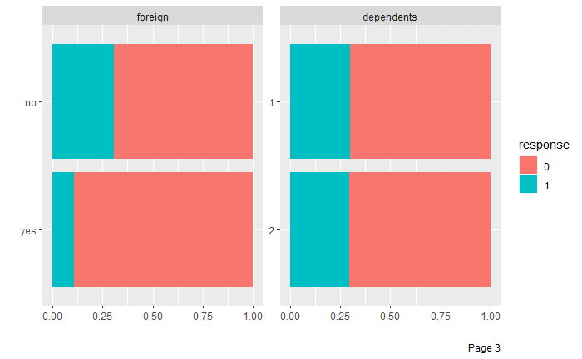
Categorical Variables (By Response)

Slide 12
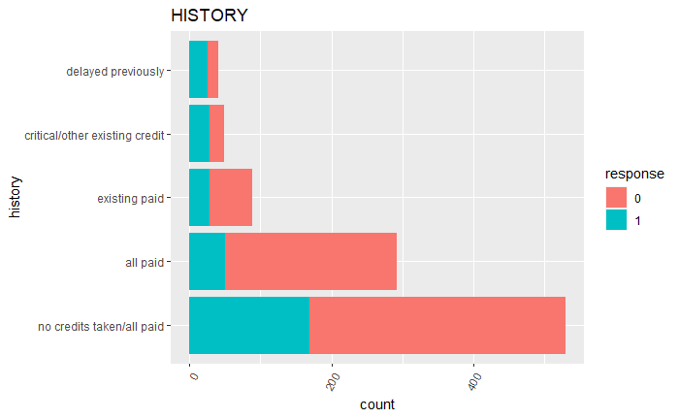
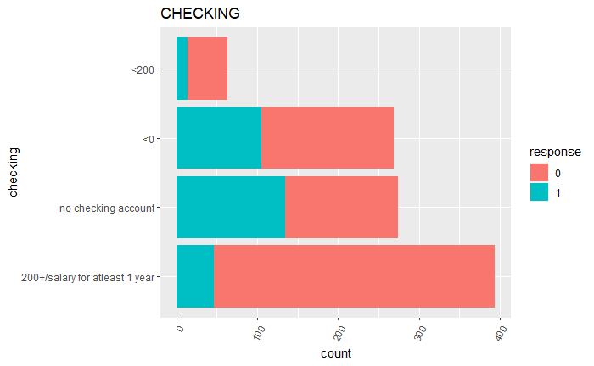
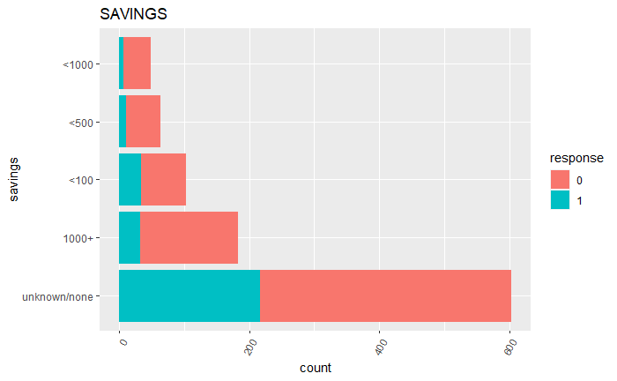
Categorical Variables

Slide 13
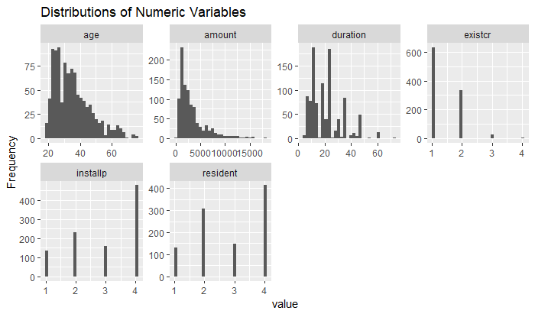
EDA using DataExplorer Package
Distributions of continuous numeric variables (age, amount, duration) are positively skewed
Existcr, install and resident are discrete numeric variables
Notes:
Existcr: # of existing credits at this bank. So, majority already have another existing credit (either 1 or 2) with the bank
Installp: this is the installment rate in % of disposable income. For most the installment rate is 4% of their disposable income
Resident: this is the # of years they’ve resided in their current residence. That kind of varies with 4 being the largest class.
**If you run these plots first on the raw data, it can be helpful by making it easier to tell which variables are imported as numeric but should be converted to factor variables.

Slide 14
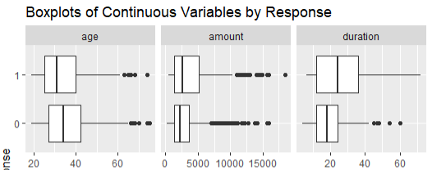
EDA – Continuous Variables
On average defaulters are younger, borrow in larger amounts and have longer loan terms (duration).
Notes:
Duration is the duration of credit in months (like the loan term)

Slide 15
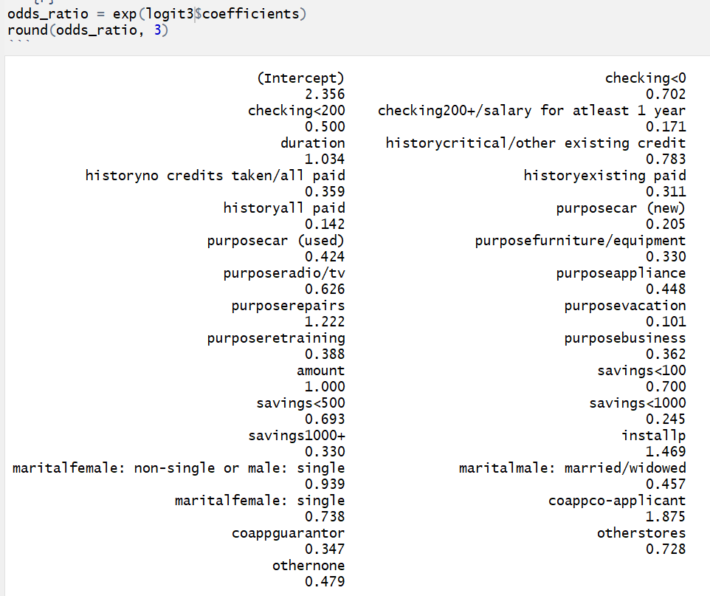
Logistic Regression
Started with a baseline model including all variables
Checked for high VIF (none)
logit3 = glm(response ~ checking + duration + history + purpose + amount + savings + installp + marital + coapp + other, data=train, family = binomial)
Logodds: longer loan terms, having a co-applicant and higher installp are associated with greater probability of default
Accuracy Rate: 70.5%

Slide 16
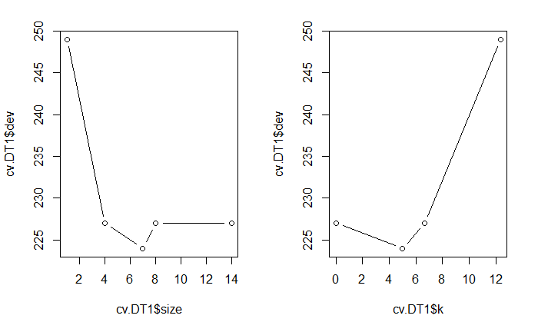
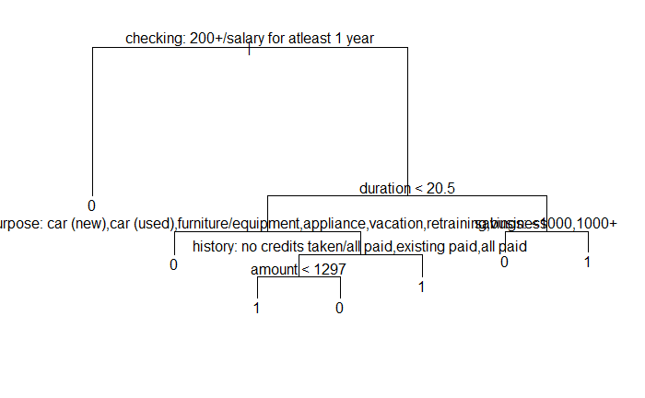
Decision Tree
Start with baseline model containing all variables and default parameters
Pruning: best size = 7
tree(response ~ . , train)
Variables used in final tree construction include: checking, duration, purpose, history, amount and savings
Most important variable: checking
Accuracy Rate: 69%

Slide 17
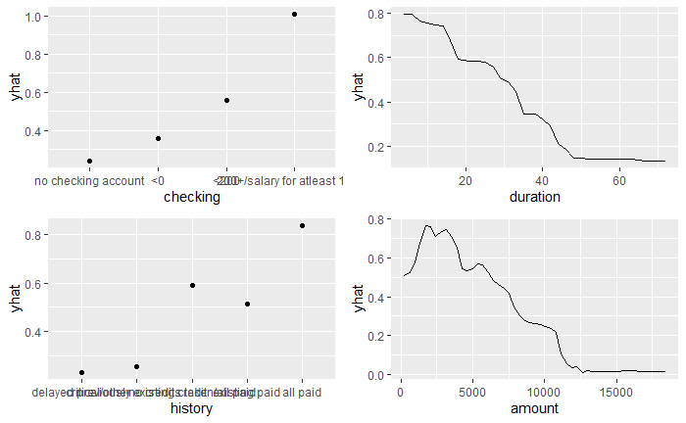
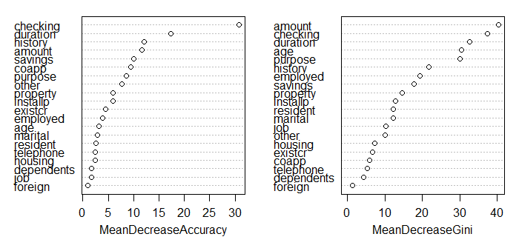
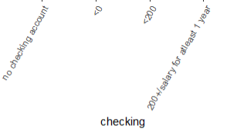
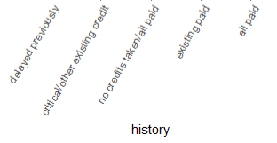
Random Forest
Start with baseline model using all variables and default parameters
Bagging and hyperparameter tuning
randomForest(response ~ ., data = train, importance = TRUE)
Accuracy Rate: 79%
Variable Importance in terms of mean decrease to accuracy:

Slide 18
Findings and Results

Slide 19
Conclusion
Goal:
Predict loan default to limit bank exposure to credit risk
Identify variables most important to default prediction
Identify the most accurate predictive model
Most important variables:
checking
duration
credit history
coapplicant
Most predictive model:
Random Forest (Accuracy Rate 79%)

Slide 20
Recommendations
Use alternative techniques and predictive models
Separate models for each loan purpose (auto, home, education, misc.)
Use clustering analysis (ex. KNN or PCA) to develop defaulter profiles and create more custom credit resolution approaches for each segment / profile to improve their credibility

